Slide 1
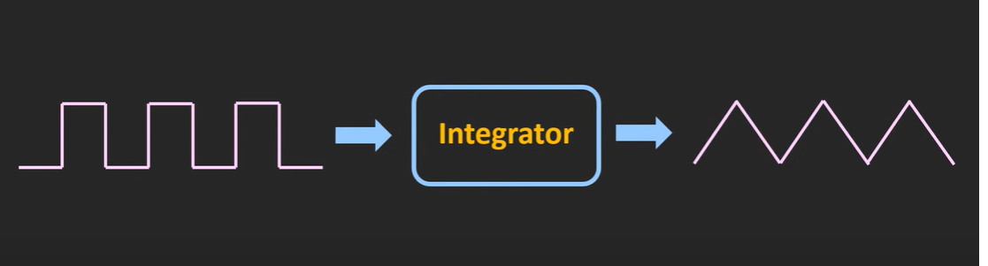
TRIANGULAR WAVE GENERATOR

Slide 2
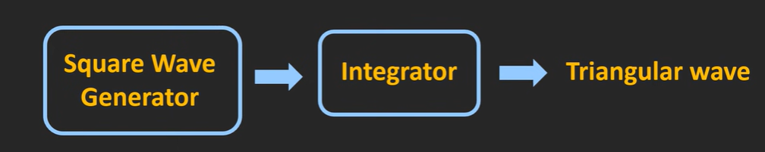
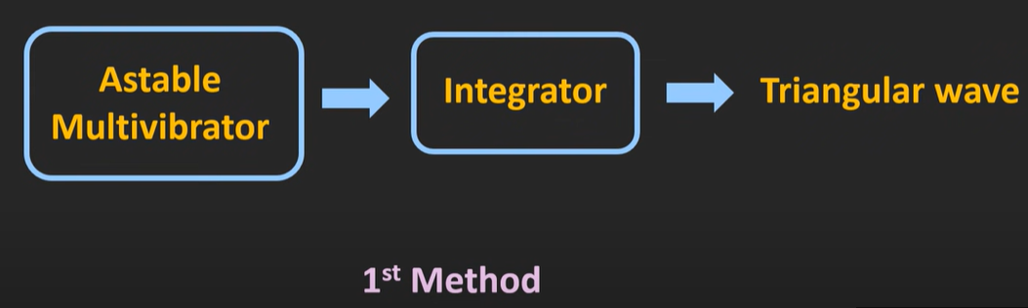

Slide 3
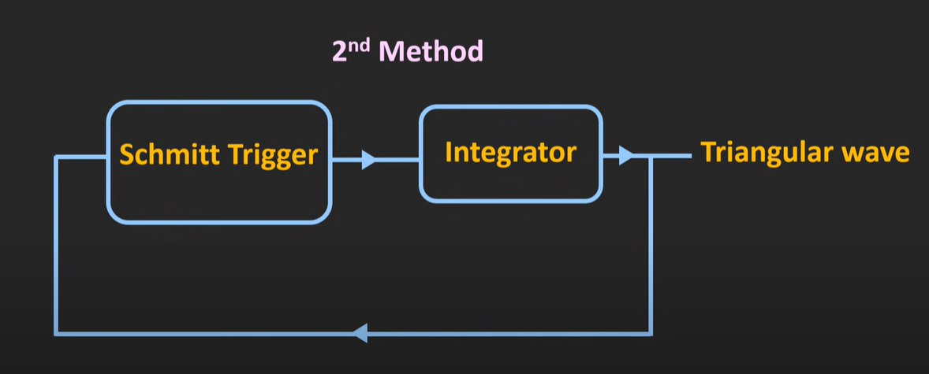

Slide 4
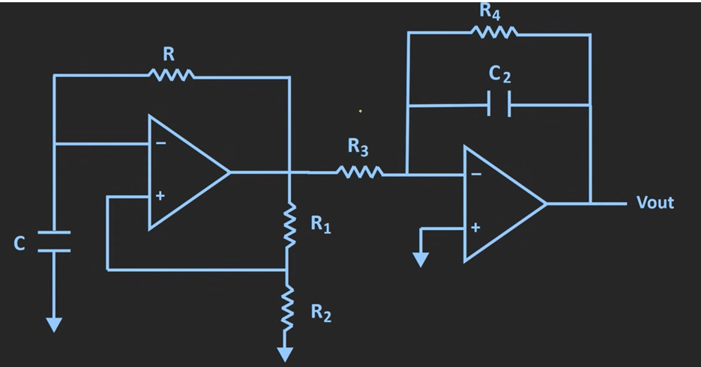
TRIANGULAR WAVE GENERATOR METHOD 1

Slide 5
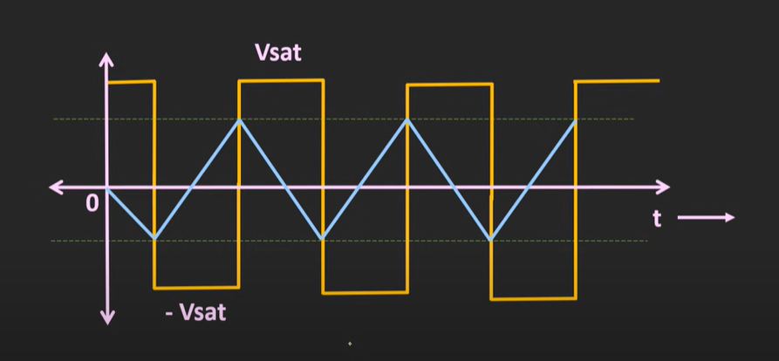

Slide 6
It is clear that freq of square & triangle wave is same.
Amp of square wave is constant at ±V_{sat}
But the amp of triangle wave will decrease as freq increases.
It is bcoz of reactance of C₂ in f/b ckt decreases at high freqs.
R₄ to avoid saturation problem at low freq (practical integratr).

Slide 7
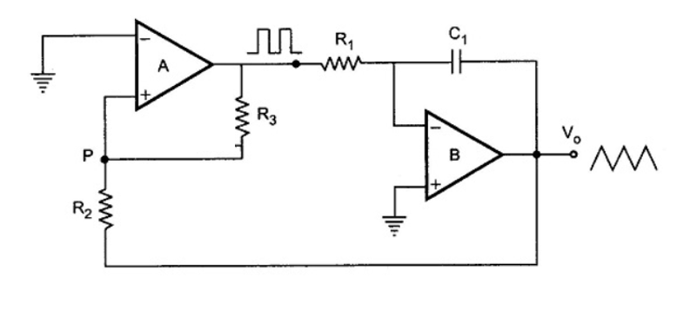
Triangular Wave Generator Using Lesser Components (Method 2)

Slide 8
Consists of 2 level comparator (Schmitt Trigger) followed by an integrator.
o/p of comparator A is a square wave of amp ±V_{sat}
This is applied to integrtr B producing triangle wave.
This triangle wave is fed back as i/p to comparator A thru a V divider R2R3.
Initially let o/p of A is at +V_{sat} .
o/p of B will be a –ve going ramp .

Slide 9
Initially R3 will be at the positive end of the A and it’s another end will be at the negative due to the B negative going Ramp.
So one end of V divider R2R3 is at +V_{sat} and other end at –ve going ramp.
So at a certain point, the P will fall below the 0.
Due to this the output of the square wave generator falls to the negative saturation voltage.

Slide 10
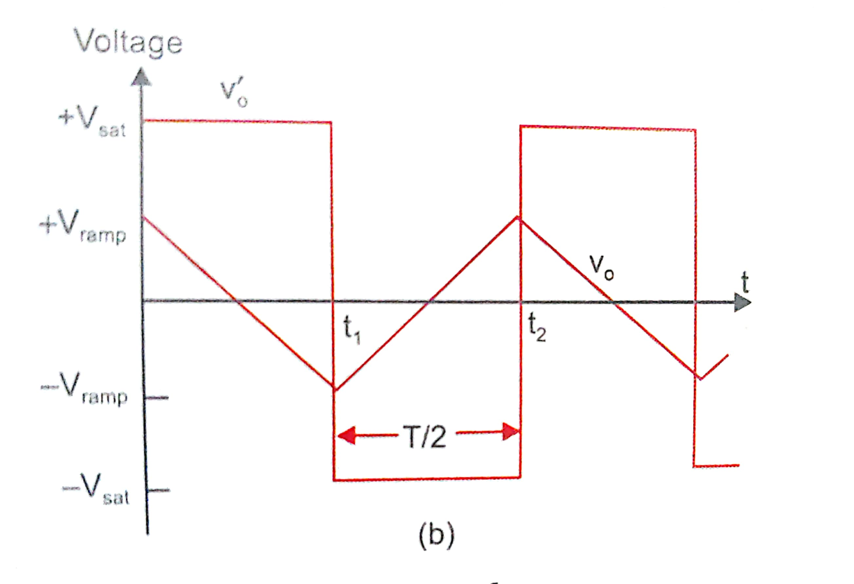

Slide 11
At t=t1, when –ve gng ramp attains a value of –V_{ramp} , effective V at pt P becomes slightly less than 0.
o/p of A switches to –V_{sat.}
o/p of B starts increasing in +ve dir. +ve gng ramp.
At t =t2, V at P becomes jz above 0.
So o/p of A again +V_{sat.}
cycle repeats and generates a triangle wave.
Freq of both wave same.
But amp of triangle wave depends on RC value of integrator and o/p of A.

Slide 12
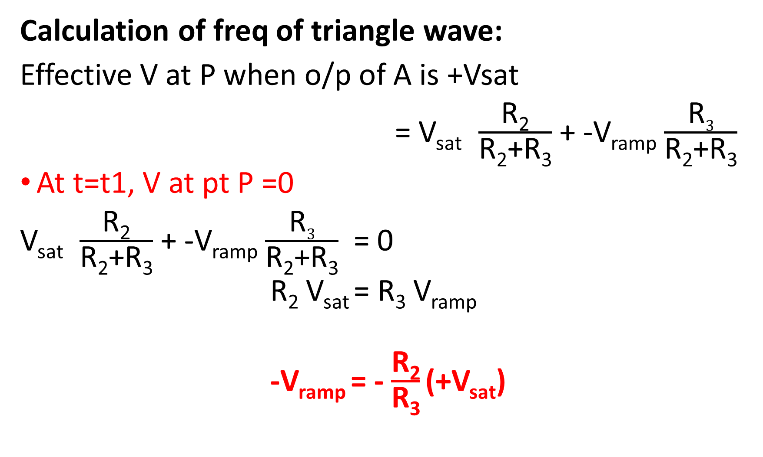
Calculation of freq of triangle wave:
Effective V at P when o/p of A is +Vsat
= V_{sat} $\frac{\text{R}\text{2}}{\text{R}\text{2}\text{+}\text{R}\text{3}}$ + -V_{ramp} $\frac{\text{R}3}{\text{R}\text{2}\text{+}\text{R}\text{3}}$
At t=t1, V at pt P =0
V_{sat} $\frac{\text{R}\text{2}}{\text{R}\text{2}\text{+}\text{R}\text{3}}$ + -V_{ramp} $\frac{\text{R}3}{\text{R}\text{2}\text{+}\text{R}\text{3}}$ = 0
R₂ V_{sat} = R₃ V_{ramp}
-V_{ramp} = - $\frac{\text{R}\text{2}}{\text{R}\text{3}}$(+V_{sat})

Slide 13
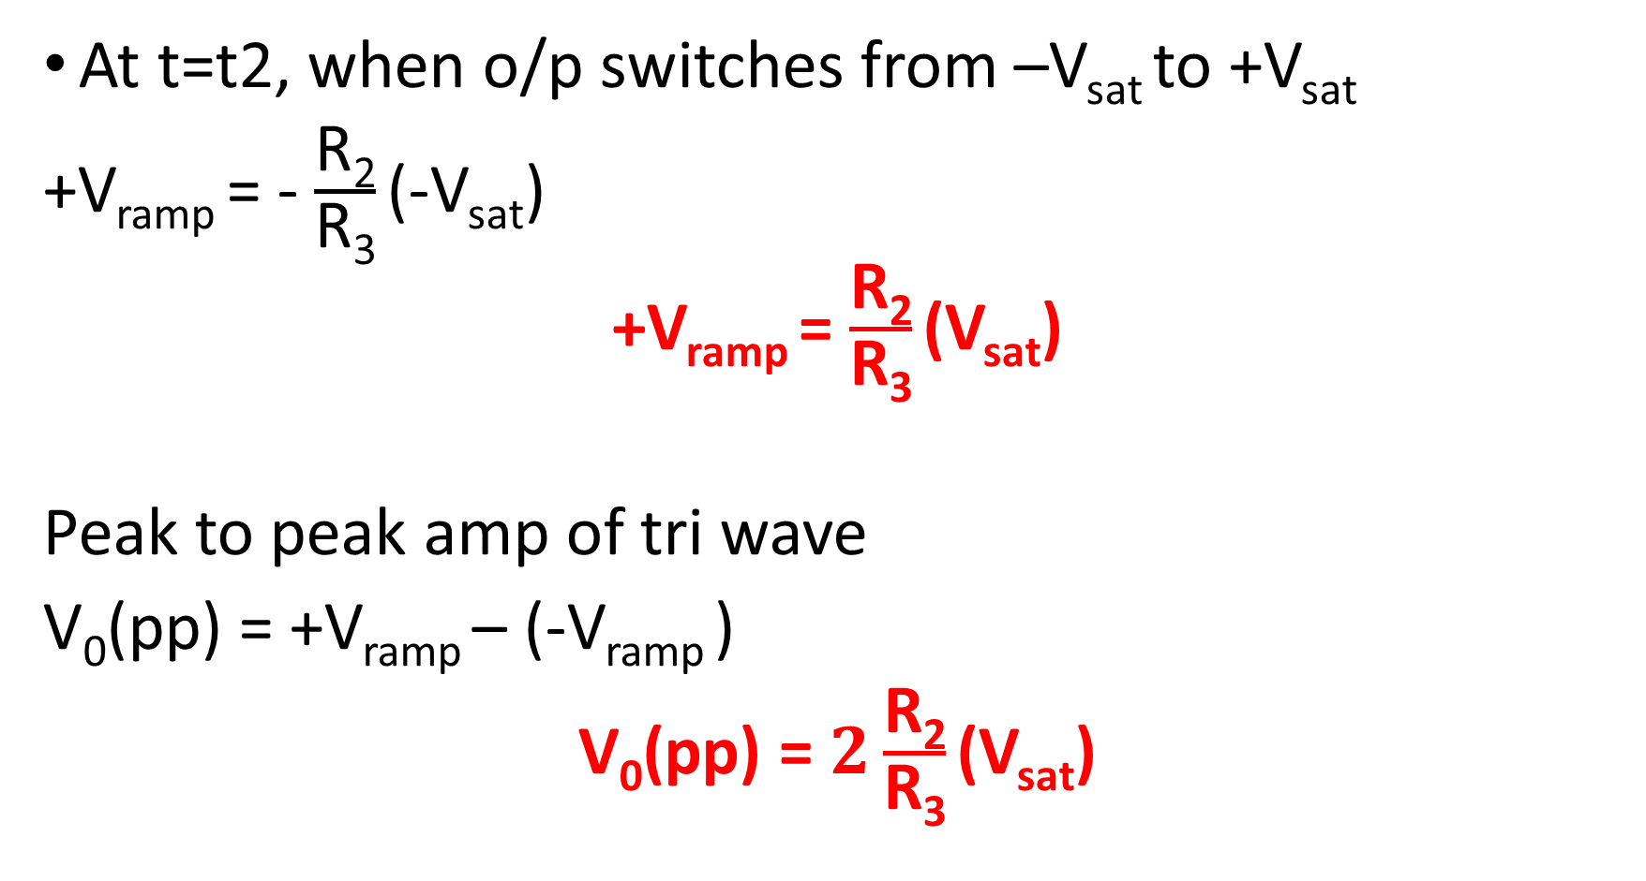
At t=t2, when o/p switches from –V_{sat} to +V_{sat}
+V_{ramp} = - $\frac{\text{R}\text{2}}{\text{R}\text{3}}$(-V_{sat})
+V_{ramp} = $\frac{\text{R}\text{2}}{\text{R}\text{3}}$(V_{sat})
Peak to peak amp of tri wave
V₀(pp) = +V_{ramp} – (-V_{ramp} )
V₀(pp) = $2\frac{\text{R}\text{2}}{\text{R}\text{3}}$(V_{sat})

Slide 14
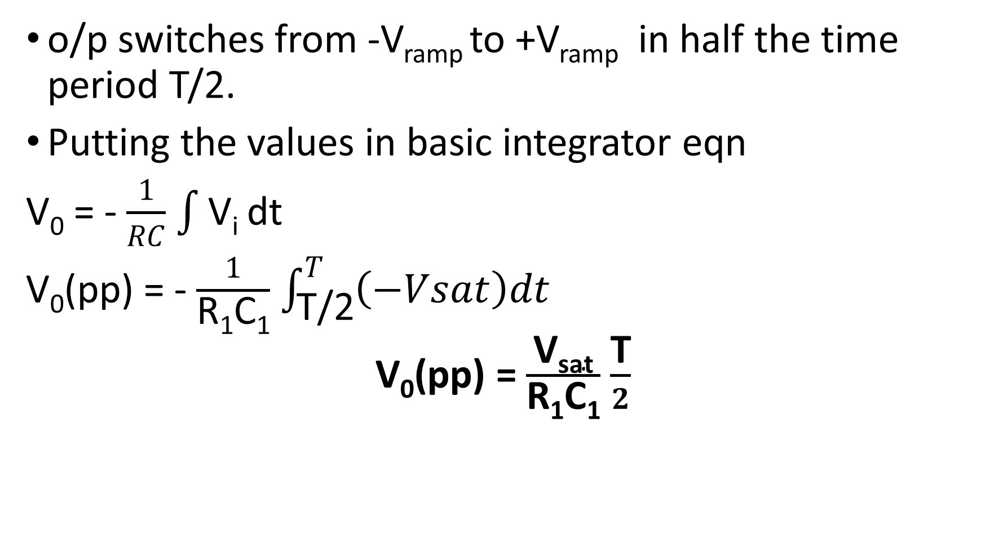
o/p switches from -V_{ramp} to +V_{ramp} in half the time period T/2.
Putting the values in basic integrator eqn
V₀ = - $\frac{1}{RC}$ $\int{\text{V}\text{i}}$ dt
V₀(pp) = - $\frac{1}{\text{R}\text{1}\text{C}\text{1}}$ $\int_{\text{T}\text{/2}}^{T}{\left(−Vsat\right)dt}$
V₀(pp) = $\frac{\text{V}\text{sat}}{\text{R}\text{1}\text{C}\text{1}}$ $\frac{\text{T}}{2}$

Slide 15
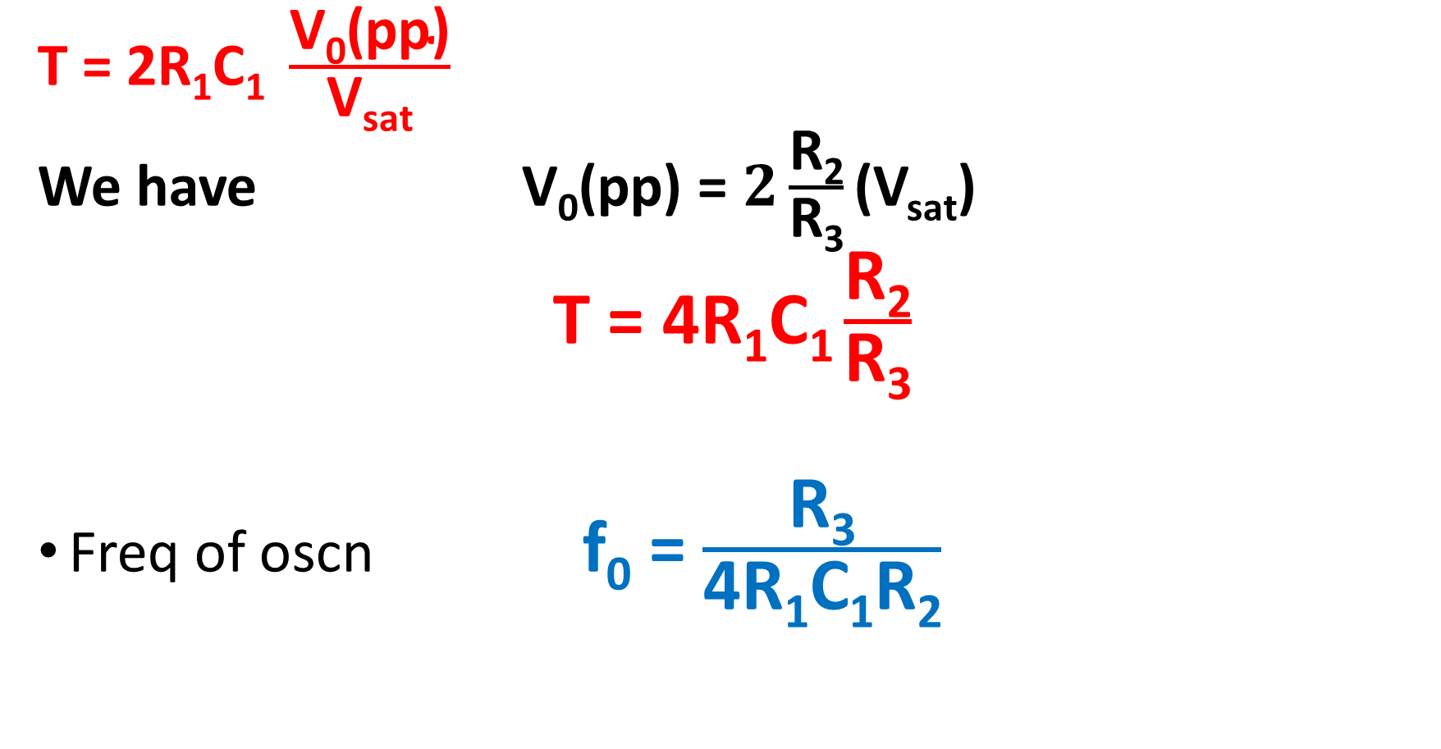
T = 2R₁C₁ $\frac{\text{V}\text{0}\text{(}\text{pp}\text{)}}{\text{V}\text{sat}}$
We have V₀(pp) = $2\frac{\text{R}\text{2}}{\text{R}\text{3}}$(V_{sat})
T = 4R₁C₁ $\frac{\text{R}\text{2}}{\text{R}\text{3}}$
Freq of oscn f₀ = $\frac{\text{R}\text{3}}{\text{4}\text{R}\text{1}\text{C}\text{1}\text{R}\text{2}}$

Slide 16
Q: design a 2KHz Triangular wave generator circuit
Hint:
Consider Op-Amp IC741 with supply voltage ±12v. Lets expect output peak to peak voltage to be 7 volts.
Assume R2= 10K ohm, Capacitor C= 0.05μF

Slide 17
Ans:
R3 = 28.5Kohm
R1=7 Kohm
We can use a varistor/potentiometer of 50k ohm to get the R3 as 28.5Kohm.
Draw the ckt with designed values.

Slide 18
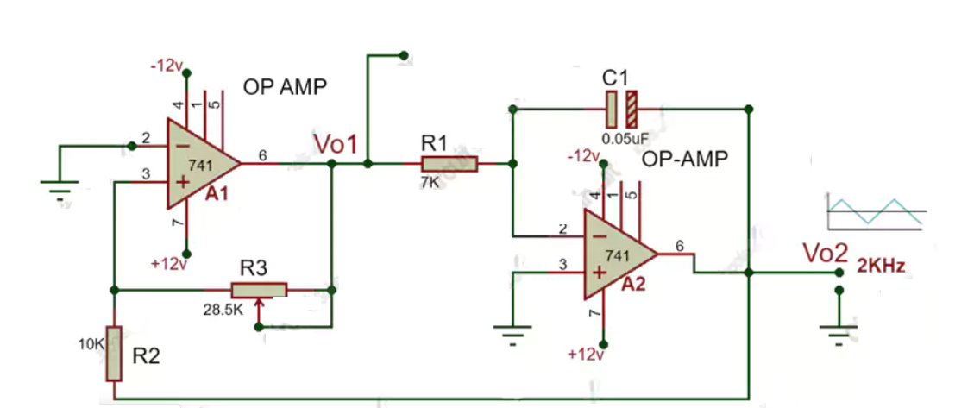

Slide 19
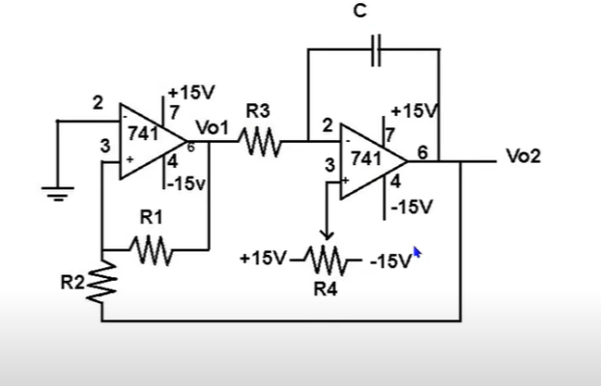
SAWTOOTH WAVEFORM GENERATOR

Slide 20
The sawtooth wave generator is one kind of linear, non-sinusoidal waveform, and the shape of this waveform is a triangular shape in which the fall time and rise time are different.
The sawtooth waveform can also be named an asymmetric triangular wave.
The triangular wave generator can be converted in to a sawtooth wave generator by injecting a variable dc voltage into the non-inverting terminal of the integrator.
A potentiometer is used in this ckt.

Slide 21
Now the output of integrator is a triangular wave riding on some dc level that is a function of R4 setting.
The duty cycle of square wave will be determined by the polarity and amplitude of dc level.
A duty cycle less than 50% will cause output of integrator be a sawtooth.
With the wiper at the centre of R4, the output of integrator is a triangular wave.
Use of the potentiometer is when the wiper moves towards −V_{EE} and +V_{cc}.

Slide 22
When the wiper moves toward negative voltage(-V); then the rise time becomes more than the fall time.
When the wiper moves towards positive voltage(+V), then the rise time becomes less than the fall time.
Freq of sawtooth wave decreases as R₄ is adjusted towards +V_{cc} or –V_{EE} .
However amp of sawtooth is independent of R₄ settings.

Slide 23
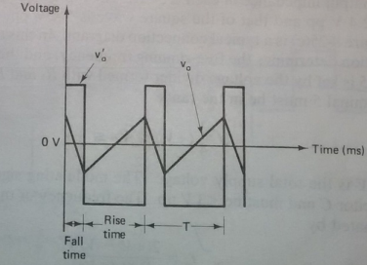
Fig: Output of sawtooth wave generator when noninverting of integrator is at some negative dc level.

